Slide 1
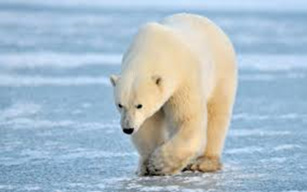
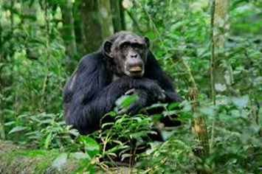
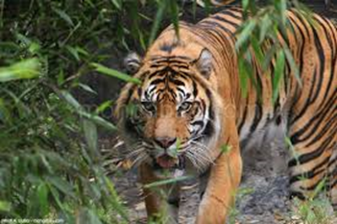
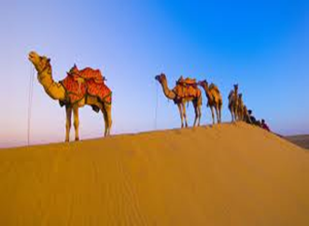
Year 1 holiday project 2024
Animals and their habitats
Next term we are learning about animals and their habitats.
Can you design a poster or fact file for an animal that lives in either the desert, the rainforest, the jungle or the arctic?
Use the back of this paper to organise your fact file.
Please return your holiday project to your teacher on Monday 3rd June 2024.
Please return your work to school on Monday 2nd June 2014

Slide 2
