Slide 2
https://bikeright.co.uk/events?area=birmingham&course=child-group

Slide 3
https://bullsinthecity.co.uk/

Slide 4
#:~:text=Monkeys%2C%20tamarins%20and%20lemurs%20%2D%20there,sheep%20from%20around%20the%20worldhttps://www.cannonhillpark.co.uk/nature-centre
https://birminghambotanicalgardens.org.uk/bbg-event/pollinate-family-25/

Slide 5
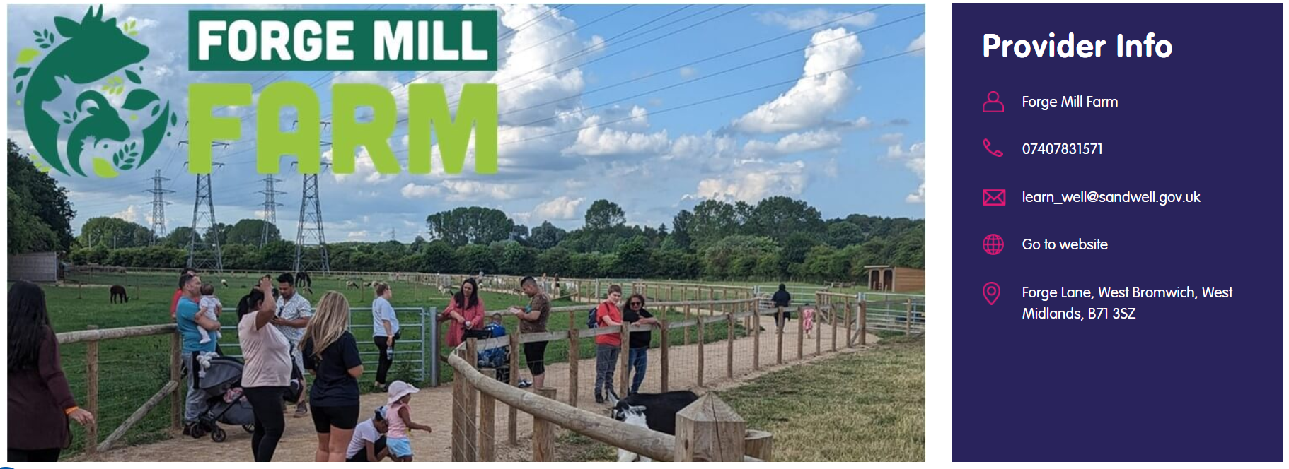
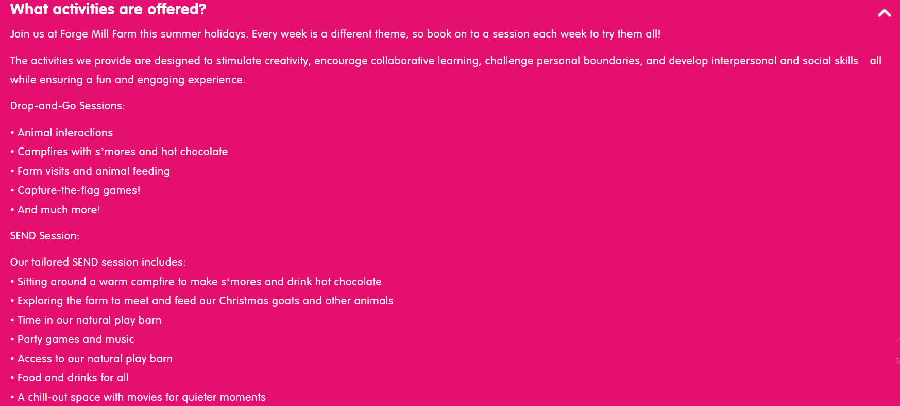
https://holidayactivities.sandwell.gov.uk/ouractivities/forge-mill-farm-summer-haf/

Slide 6
https://www.brindleyplace.com/event/brindley-film-festival/

Slide 7
https://community.petsathome.com/events/child-workshop/

Slide 8
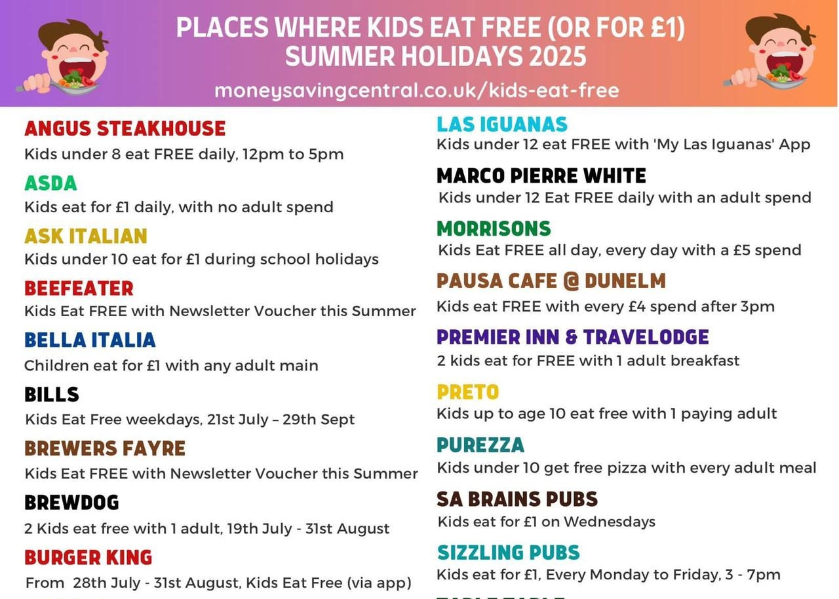
Places to eat

